Slide 1
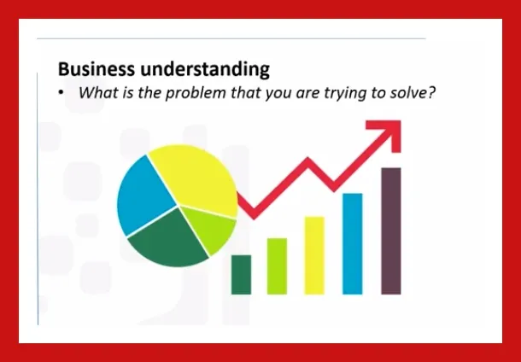
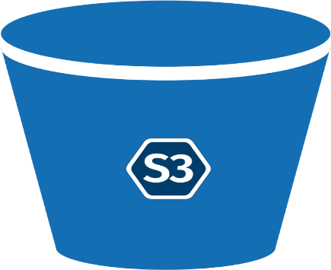
Bird Detection and Tracking for Healthcare Monitoring
Model Building & Training using Yolo V8 model
OCR(Optical character Recognition) on region of interest
Monitoring And Maintenance of Model
Data Acquisition
Image Augmentation
Model Deployment using Flask , Streamlit Aplication or Edge deployment
Data Annotation
Normalization
Hyperparameter Tuning
Segmentation Techniques
Bussiness & Data Understanding
Validate and Evalute the model on Test Images
Train , Test & Split the data
Drawing Inferences using PowerBI reports & Dashboards. ( Publish Or Review )
Extraction Of Features
Save the model
Save

